Slide 1


Tweet like Trump
An exploration of deep learning and natural language processing into the mind of D. Trump
Presentation by Ed Chin
November 11, 2016

Slide 2
What did I do with
26,204 tweets from Donald Trump from 2009-2016
10 campaign speeches in 2016
And many sleepless hours agonizing over the results of the presidential election
I built a character-based text generation model using a recurrent neural network (LSTMs variant) to simulate Trump’s tweets

Slide 3
Why Donald Trump?
Because he is a polarized figure who trolls the twitter-verse like nobody’s business
Because he exuded so much negative sentiment in his daily rhetoric it would be a complete waste of time performing a sentiment analysis on him
Because you are going to hear from him for at least four more years…might as well get used to it

Slide 4


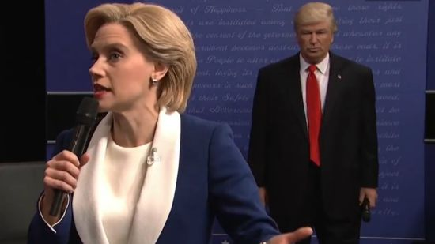

Ok, let’s get the boring technical stuff out of the way
Going Deep…

Slide 5
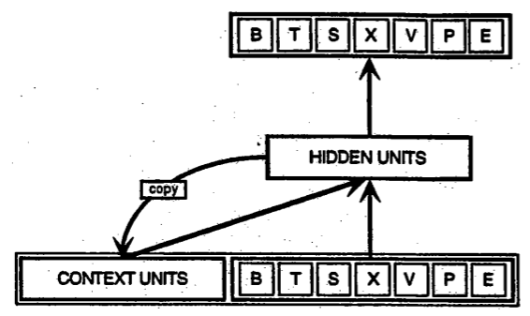
Why Recurrent Neural Network?
RNN takes as their input not just the current input it sees, but also one step back in time
It combines the present and the recent past to respond to new data, much as we do in life
With its ability to have “memory”, RNN dramatically improves performance over CNN (Word2Vec) or Markov Chain Generator

Slide 6
What is Long Short Term Memory Units (LSTMs)?
LSTMs is a variation of RNN that is surprising effective in combating the vanishing gradient problem
LSTM helps preserves the error that can be back-propagated through time and layers
Text contains recurrent themes at varying intervals, something that LSTMs are good at capturing

Slide 7
How did I train the model?
Single character classification problem with 52 classes (unique characters) and as such is defined as optimizing log loss, as opposed to classification accuracy
2,237,658 characters in corpus
Two layers LSTM with 256 hidden nodes in first layer and 512 nodes in the second layer, with 0.2 dropout after each layer (~1.9mm parameters)
Model was optimized after ~35 epochs at 1.0306 loss rate over a 2 day period

Slide 8











Techniques and Tools

Slide 9
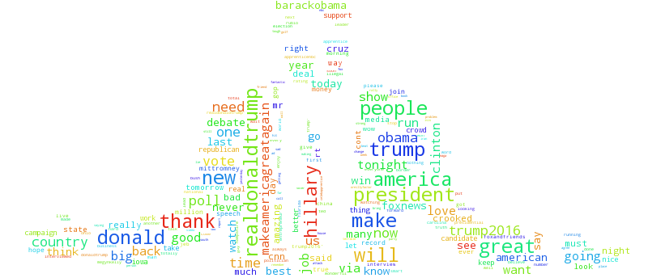
Now comes the fun stuff… Boom-shaka-laka
App is live - http://52.55.95.182:8080

Slide 10
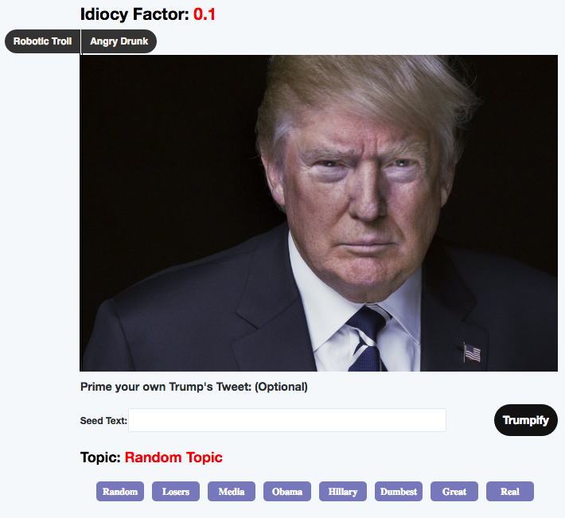
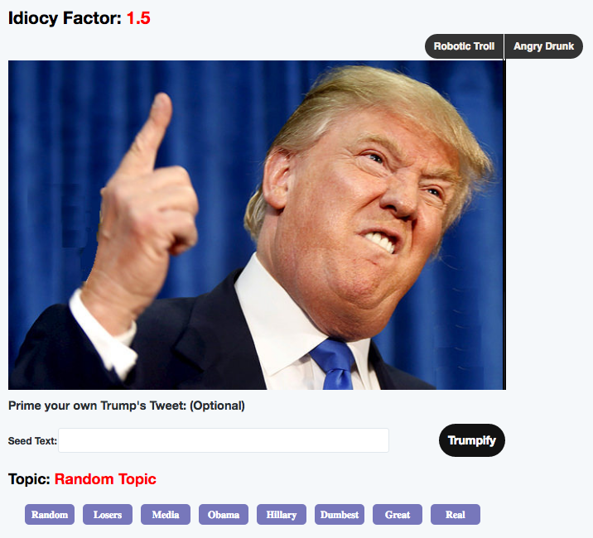
Step 1: Which Trump do you want?
Increasing temperature, aka “Idiocy Factor”, will give more diversity but at cost of more mistakes

Slide 11
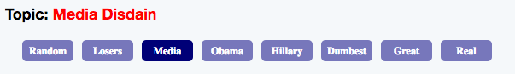
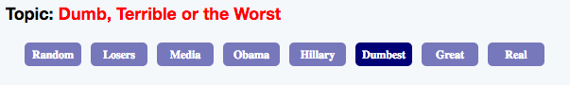
Step 2: Choose a Topic
The key words were chosen based on a topic modeling exercise using LDA

Slide 12

Step 3: Click “Trumpify” to get live tweets
Adjust the sentence length using the slider
Wait ~5 seconds for the model to generate results

Slide 13
Sample Outputs from Model
Republicans must stop relying on losers like @karlrove and jeb bush and what do it was a total disaster. not going to be a ticket of the polls. I mean, I mean, we’ll have a country. I dont know
Is @realdonaldtrump debating crooked @hillaryclinton said they want a great thing in the world trade deals. I got the money and they have to do it. So were going to be able to do well with the world. I was a tremendous deal with mexico and they dont want to do that. I dont know what
Jon stewart is a joke, not very bright and totally overrated in charlotte of the world to call for a record the real work not to see each other for a support. The republicans have scandal country that i had a long time i was a no time for the history of the president obama is a total disaster

Slide 14
Reflecting on Model Results
Very impressive considering the model had to learn English completely from scratch and know where to put commas and spaces
The trained LSTM model shows glimmer of insights
It frequently supports its own argument
It rambles just like Trump
Model does a good job walking the fine line between memorization and creativity

Slide 15
Future Work
Remove punctuations from source text, and therefore reduce model’s vocabulary for training
Train model on padded sentence rather than random sequences of work
Add more layers and neurons and tune the dropout percentage.
Train over 100 epochs
Apply regularization to combat overfitting

Slide 16
Contact Info
Ed Chin
Email: echin6@gmail.com
Linkedin:
https://www.linkedin.com/in/edwin-chin-62392b1
Blog: echin6.github.io
Repo: echin6/metis_projects

